Slide 1

How to detect the manipulation of financial statements in EU financial incentives in Portugal
Susana Fernandes Raul M. S. Laureano Luís M. S. Laureano
(susana.fernandes@iscte-iul.pt) (raul.laureano@iscte-iul.pt) (luis.laureano@iscte-iul.pt)
48th WCARS
Madrid, Spain
September 25th2020

Slide 2
Outline
Introduction
Relevance of the Subject and Objectives
Theoretical Framework
Key Research Question
Methodology
Results
Contributions
Conclusions
48th WCARS, September 25th 2020

Slide 3
Introduction
The theme of the research is the analysis of companies' applications for European funds using advanced analytics.
https://audiovisual.ec.europa.eu/en/video/I-193956?&lg=OR
Video NextGeneration
48th WCARS, September 25th 2020

Slide 4

Introduction
48th WCARS, September 25th 2020

Slide 5
Introduction
48th WCARS, September 25th 2020
Notes:
Pela competencia delegada aos organismos intermédios as suas competencias são.......

Slide 6
Introduction
48th WCARS, September 25th 2020
Notes:
Pela competencia delegada aos organismos intermédios as suas competencias são.......

Slide 7
Relevance of the Subject and Objectives
48th WCARS, September 25th 2020
Notes:
Doubts about the effectiveness of using EU fundsCompliance with financial requirements before, during and after applicationsScarce human resources for project analysis make institutions inefficientFinancial funds for companies that become unviable in the medium or long termlack of a model that combines results management and datamining techniques

Slide 8
Relevance of the Subject and Objectives
48th WCARS, September 25th 2020

Slide 9
Theoretical Framework
48th WCARS, September 25th 2020

Slide 10
Key Research question
How can advanced analytics and earnings management analysis contribute to improving the efficiency and effectiveness of the EU's financial aid process to Portuguese companies?
Source: https://www.google.com/url?sa=i&url=https%3A%2F%2Fwww.recordedfuture.com%2Fthreat-intelligence-data%2F&psig=AOvVaw0_DetAI9Iwn-SyLW29kSpb&ust=1595084375328000&source=images&cd=vfe&ved=0CAIQjRxqFwoTCOjngtLG1OoCFQAAAAAdAAAAABBV
48th WCARS, September 25th 2020

Slide 11
Methodology
Data: 442 Portuguese companies that received financial incentives:
  206 companies from 2013
  236 companies from 2014
  Financial statements from 2005 to 2017
  Dependent variables: The Beneish M-Score value: If M-Score> -1.89 => Evidence of result manipulation
  Independent variables: several financial ratios and the eight indicators from the Beneish Model built using the Financial Statements
  Methods: Methods of descriptive statistics, hypotheses tests from SPSS Statistics (version 25) and the mathematical model of M-Score by Beneish (1999, 2012) and the use of logistic regression, decision trees C5, Quest and CART.
48th WCARS, September 25th 2020

Slide 12
Results
48th WCARS, September 25th 2020

Slide 13
Results
48th WCARS, September 25th 2020

Slide 14
Results
There is statistical evidence that:
30% of companies manipulate their results
There is evidence of Aggressive Accounting, through:
  DSRI and TATA - namely from revenue inflation
There is evidence of Fraud, through:
    SGI - Companies show rapid sales growth
    AQI and LVGI with excessive capitalization of assets or deferred costs
48th WCARS, September 25th 2020

Slide 15
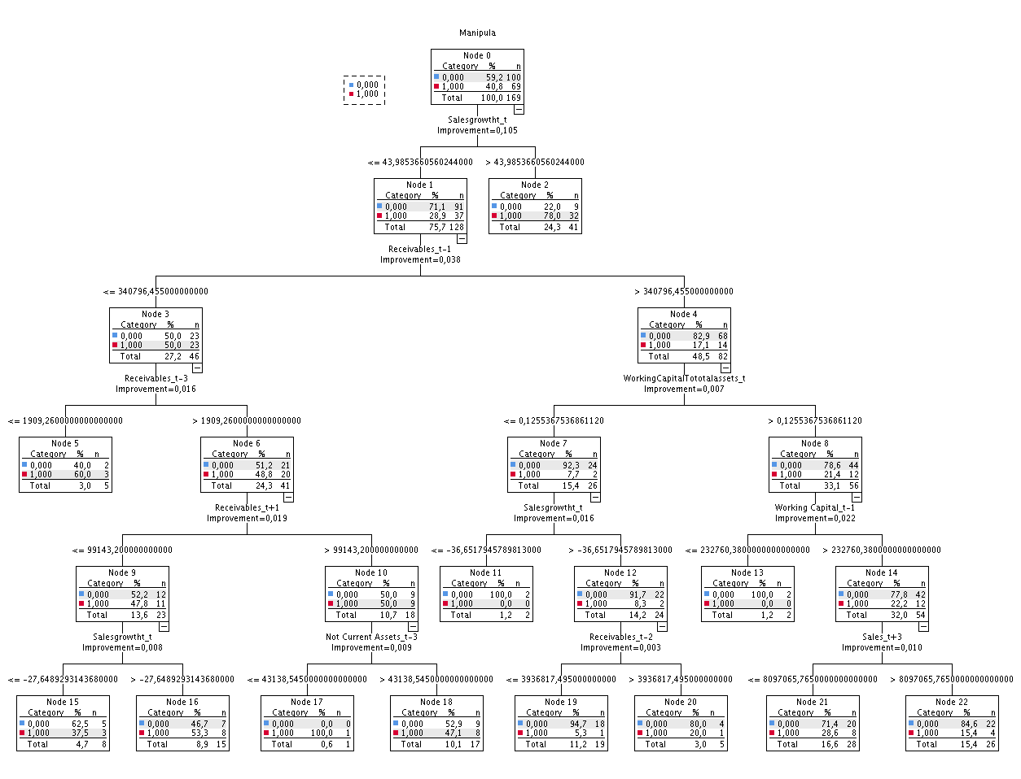
Results
What is the profile of the manipulators
48th WCARS, September 25th 2020
Notes:
O modelo com maior....Se o crescimento das vendas é inferior a 43,99 e a rubrica de clientes dois anos antes é superior a 340.794,455 e o rácio fundo maneio sobre o total ativo no ano anterior for inferior ou igual a 0,126 e ..... então existe propensão para não manipula

Slide 16
Results
The decision trees, with the CART algorithm, obtained the best performance (precision: 76.8%, sensitivity: 81.2%, specificity: 71.4%);
The companies that manipulate their results tend to be from the Center region of Portugal;
The sectors identified were:
i) services; ii) tourism, and iii) the incentive system for the qualification of SMEs for the industry sector;
The features considered most important for predicting manipulation were the growth in sales and the ratio of working capital to total assets.
48th WCARS, September 25th 2020

Slide 17
Contributions
New context in Manipulation of results, when applying the models for detecting this manipulation in financial statements of companies that applied for financial incentives;
Analysis of applicants for European Funds, focused on SMEs, using advanced analytical models .
Reformulation of rules for granting financial incentives;
More efficiency when directing analysis and verification to accounts that indicate aggressive accounting or fraud;
Resource optimization for analysis and verification;
Gains in the effectiveness in granting incentives from potentially viable companies in the medium / long term;
Increase contractual compliance.
48th WCARS, September 25th 2020

Slide 18
Conclusions
There is not only manipulation of the results before, but also after the application for financial incentives.
It is possible to obtain good predictive models for finding evidence of results with indicators of the financial situation of the companies and indicators of the mathematical model of Beneish (2009, 2013);
The evaluation process of applications can be more responsive and transparent;
As a result, decision-making processes can be more efficient and effective
48th WCARS, September 25th 2020

Slide 19
Thank you!
Please contact me at:
susana.fernandes@iscte-iul.pt
Or
raul.laureano@iscte-iul.pt
Or
luis.laureano@iscte-iul.pt

